Slide 1
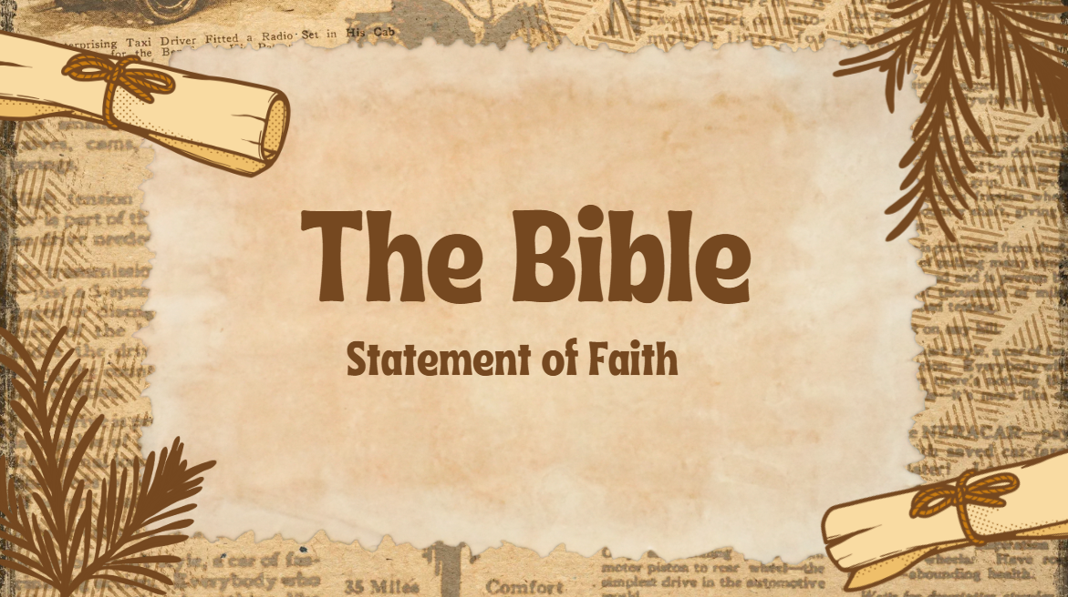

Slide 2
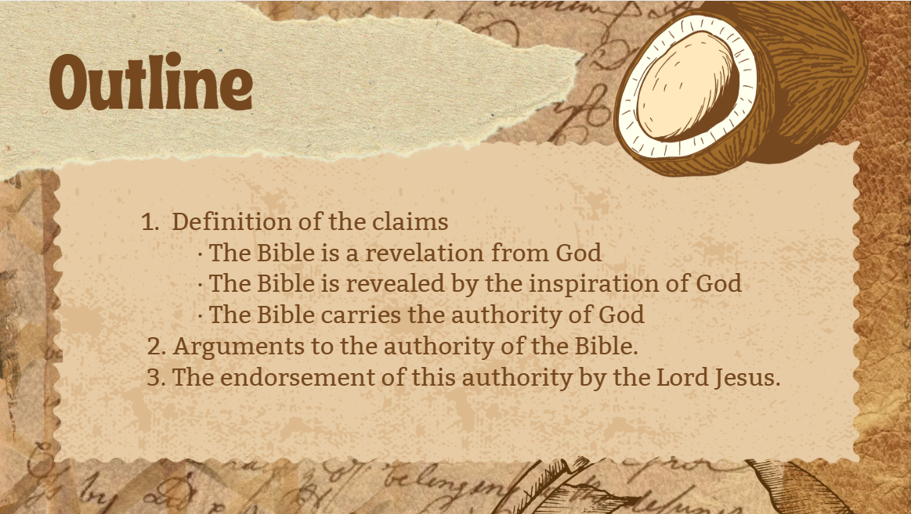

Slide 3
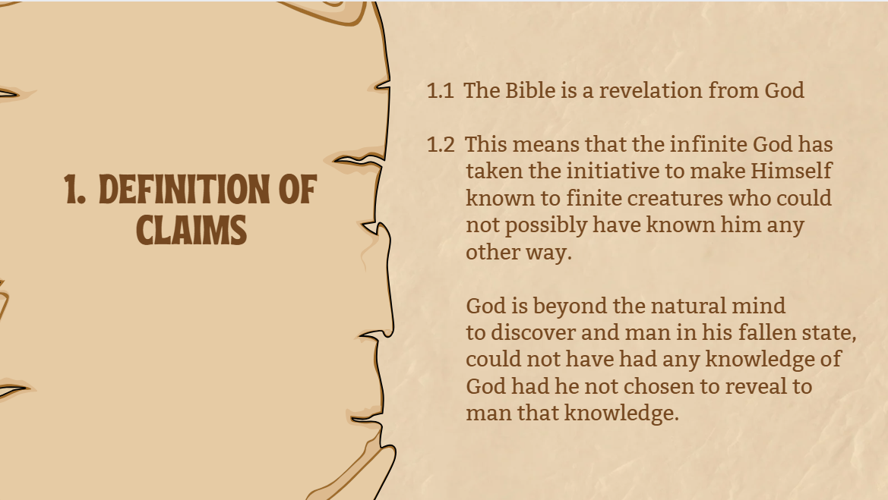

Slide 4

Isaiah 55:8-9 (NIV)
⁸“For my thoughts are not your thoughts, neither are your ways my ways,” declares the Lord.
⁹ “As the heavens are higher than the earth, so are my ways higher than your ways and my thoughts than your thoughts.

Slide 5

  1.3. The Bible is a revelation
  given by the inspiration of God.
2 Timothy 3:16-17 (NIV)
All Scripture is God-breathed and is useful for teaching, rebuking, correcting and training in righteousness, ¹⁷ so that the servant of God may be thoroughly equipped for every good work.
Exodus 34:27-28 (NIV)
Then the Lord said to Moses, “Write down these words, for in accordance with these words I have made a covenant with you and with Israel.” ²⁸ Moses was there with the Lord forty days and forty nights without eating bread or drinking water. And he wrote on the tablets the words of the covenant—the Ten Commandments.
Notes:
This means that the chief mode with which God chose to reveal himself is by a process of verbal communication called inspiration.
This does not mean inspiration in the same sense that a poet or a musician is inspired to compose, but that whatever was written by the Bible authors, was spoken to them and through them by God.
2 Timothy 3:16-17; Exodus 34:27-28.

Slide 6

The Bible is verbally inspired.
The very words used by the writers in the original text were inspired by God. The Christian claim for inspiration is not on the translations but on the original text only.
1 Corinthians 2:13 (NIV)
This is what we speak, not in words taught us by human wisdom but in words taught by the Spirit, explaining spiritual realities with Spirit-taught words
  1.3. The Bible is a
  revelation
  given by the
  inspiration of God.

Slide 7
The Bible is dually authored.
The process of inspiration as given by God was not a mechanical one. God spoke to and through the authors without violating their personalities, backgrounds and experience but instead fully utilizing them to convey a distinct divine message.
The messenger is often a part of the message himself. Examples of these are Hosea, a prophet of God's love; Amos, a prophet of God's justice; Paul, an apostle of grace and faith; Peter, an apostle of hope.
  1.3. The Bible is a
  revelation
  given by the
  inspiration of God.
Notes:
Amos was a shepherd and farmer from the Judean village of Tekoa who had a vision and became a prophet for the Lord.
his own testimony he was “neither a prophet nor the son of a prophet” when the Lord called him into service (Amos 7:14). That is, he had not been trained as a prophet, nor was he seeking the office. The Lord simply decided to use him.

Slide 8
Every word is only as authoritative as the person who spoke it. If the Bible is a revelation given by the inspiration of God, then it carries the authority of God.
If God is who He is as described in the Bible, then respect for the Bible directly reflects respect for God and vice versa. Everyone then who claims to believe in God is subject to the authority of God's Word, the Bible.
1.4 The Bible has the
authority of the Word
of God.
Authority here means the power or the weight which inheres the Scriptures because of what it is, the Word of God.

Slide 9

ARGUMENTS TO THE AUTHORITY OF
THE SCRIPTURES
  2.1. The historic churches have consistently
  maintained and defended the divine origin
  of the Scriptures.

Slide 10
ARGUMENTS TO THE AUTHORITY OF
THE SCRIPTURES
  2.2 The claims of the writers themselves
  Genesis 1 - " And God said …" is found 9 times; Pentateuch - " The Lord spoke…" is found 560 times; Isaiah claims his message is from God 40 times; Jeremiah claims his message is from God 100 times.
  Throughout the Bible, the authors claim their message is from God 3800 times.
  The cross authorization of the writers themselves.

Slide 11
ARGUMENTS TO THE AUTHORITY OF
THE SCRIPTURES
  2.3. The Bible's coherence and unity.
  Consider the composition of the Bible: It is composed of 39 Old
  Testament books and 27 New Testament books written by 40
  authors in 2 languages in a time span of about 1500 years.
  Despite these factors as listed above, all these books point to only
  one message, which is inherent throughout the Scriptures, and that
  is salvation. The best explanation for these is the inspiration of the
  one Divine Author behind all these human authors

Slide 12

ARGUMENTS TO THE AUTHORITY OF THE SCRIPTURES
2.4 The phenomenon of fulfilled prophecies and miracles
There are about 3,300 verses in the bible which are directly or indirectly related to prophecy. In the life of the Lord Jesus alone, there are over 300 prophecies fulfilled.
The Christian experience testifies to the innumerable miracles happening daily in the lives of those who believe and pray according to the promises of the Bible.

Slide 13
ARGUMENTS TO THE AUTHORITY OF THE SCRIPTURES
2.5 The nobility and the dignity of its message.
Example is the biblical message on love.
2.6 The relevance and continuing popularity of its message
Examples are the Sermon on the Mount and the Proverbs.
2.7 The power of the Bible to change human lives.

Slide 14
ARGUMENTS TO THE AUTHORITY OF THE SCRIPTURES
2.8 The inward witness of the Holy Spirit
Example is the Emmaus Road experience.
Luke 24: 13-35
Luke 24:32
They asked each other, “Were not our hearts burning within us while he talked with us on the road and opened the Scriptures to us?”

Slide 15
ARGUMENTS TO THE AUTHORITY OF THE SCRIPTURES
2.9 The endorsement of it's authority by the Lord Jesus himself
This is the most decisive of all these arguments as his attitude towards the Scriptures determines also the attitude of his followers towards the same.

Slide 16

3. THE ENDORSEMENT OF THE BIBLE
BY THE LORD JESUS
3.1 His endorsement of the Old Testament
In His personal conduct. In the temptation in the wilderness, he submitted to the authority of the Scriptures.
Matthew 4:1-10
Notes:
Mathew 4:4 - temptation to turn the stone into bread
⁴ Jesus answered, “It is written: ‘Man shall not live on bread alone, but on every word that comes from the mouth of God.’
Deut. 8:3
³ He humbled you, causing you to hunger and then feeding you with manna, which neither you nor your ancestors had known,
to teach you that man does not live on bread alone but on every word that comes from the mouth of the Lord.
Psalm 91:11-12
For he will command his angels concerning you
to guard you in all your ways;
¹² they will lift you up in their hands,
so that you will not strike your foot against a stone.
Matthew 4:5-7 throw yourself
⁵ Then the devil took him to the holy city and had him stand on the highest point of the temple. ⁶ “If you are the Son of God,” he said, “throw yourself down. For it is written:
“‘He will command his angels concerning you,
and they will lift you up in their hands,
so that you will not strike your foot against a stone.’^{[c]}”
⁷ Jesus answered him, “It is also written: ‘Do not put the Lord your God to the test.’^{[d]}”
Deut. 6:16
¹⁶ Do not put the Lord your God to the test as you did at Massah
Temptation – the devil showed the Lord all the kingdoms of the world – bow down and worship me
Mathew 4:8-10
⁸ Again, the devil took him to a very high mountain and showed him all the kingdoms of the world and their splendor. ⁹ “All this I will give you,” he said, “if you will bow down and worship me.”
¹⁰ Jesus said to him, “Away from me, Satan! For it is written: ‘Worship the Lord your God, and serve him only.’^{[e]}”

Slide 17
3. THE ENDORSEMENT OF THE BIBLE
BY THE LORD JESUS
3.1 His endorsement of the Old Testament
In the fulfillment of his mission. He acknowledged the Scriptures to be prophetic to His mission. He claimed for Himself the titles and the works of the Messiah.
Mark 12:10
10 Haven’t you read this passage of Scripture:
“‘The stone the builders rejected
has become the cornerstone;
Notes:
12:10, 11 All this was in fulfillment of the OT Scriptures. In Psalm 118:22-23
Psalm 118:23 NIV
Psalm 118:22-23
²² The stone the builders rejected
has become the cornerstone;
²³ the Lord has done this,
and it is marvelous in our eyes.
it was prophesied that the Messiah would be rejected by the Jewish leaders in their building plans. They would have no place for this Stone. But following His death, He would be raised from the dead and given the place of preeminence by God. He would be made the chief cornerstone in God’s building.

Slide 18
3. THE ENDORSEMENT OF THE BIBLE
BY THE LORD JESUS
3.1 His endorsement of the Old Testament
In the controversies. To Him, the Scriptures are the final authority to settle any issue, always referring to them to silence His enemies. To the Lord, the Scriptures are not debatable. So should they be to the believer.
Luke 10:26-28 “What is written in the Law?” he replied. “How do you read it?” 27 He answered, “‘Love the Lord your God with all your heart and with all your soul and with all your strength and with all your mind’[a]; and, ‘Love your neighbor as yourself.’” 28 “You have answered correctly,” Jesus replied. “Do this and you will live.”
Notes:
Deut. 6:5 Love the Lord your God with all your heart and with all your soul and with all your strength.
Lev. 19:18 “‘Do not seek revenge or bear a grudge against anyone among your people, but love your neighbor as yourself. I am the Lord.

Slide 19

3.2 His endorsement of the New Testament
The New Testament was written by authors who were either chosen personally by the Lord or were directly related to them in the work.
As in the Old Testament where God chose the prophets to give a true record and interpretation of what he was doing, He did the same by the Lord Jesus' selection of the apostles who were responsible to do the same.

Slide 20
3.2 His endorsement of the New Testament
Luke 6:12-16 (NIV)
12 One of those days Jesus went out to a mountainside to pray, and spent the night praying to God. 13 When morning came, he called his disciples to him and chose twelve of them, whom he also designated apostles: 14 Simon (whom he named Peter), his brother Andrew, James, John, Philip, Bartholomew, 15 Matthew, Thomas, James son of Alphaeus, Simon who was called the Zealot, 16 Judas son of James, and Judas Iscariot, who became a traitor.

Slide 21
3.3 Arguments to the uniqueness and reality of the
apostolic authority
They had a personal call and authorization from the Lord Jesus. This is clear in the case of the twelve. Paul claimed that His commission to be an apostle was "sent" not from men nor by men but by the Lord Jesus Christ.
Galatians 1:1 (NIV)
Paul, an apostle—sent not from men nor by a man, but by Jesus Christ and God the Father, who raised him from the dead

Slide 22
3.3 Arguments to the uniqueness and reality of the
apostolic authority
→They had an eyewitness experience of the Lord. In fact, this was one of the requirements for the choosing of a replacement for Judas Iscariot. As for Paul, he has seen the Lord.
Acts 1:15-26 (NIV)
Their message was confirmed and is continually being confirmed by signs and wonders
Hebrews 2:3-4 (NIV)
How shall we escape if we ignore so great a salvation? This salvation, which was first announced by the Lord, was confirmed to us by those who heard him. 4 God also testified to it by signs, wonders and various miracles, and by gifts of the Holy Spirit distributed according to his will.
Notes:
The names of two men were put forward as possessing the necessary qualifications, Joseph … surnamed Justus, and Matthias.
But which one was to be chosen? The apostles committed the matter to the Lord, asking for a revelation of His choice. Then they cast lots, and Matthias was indicated as the proper successor to Judas

Slide 23

3.4 Summary
The Lord Jesus endorsed the authority of the Old Testament by submitting to it in his life.
He endorsed the authority of the New Testament by selecting the apostles who recorded it or who personally knew the writers who did. Examples are Matthew, John, Mark, Luke, Peter and Paul.

Slide 24

The Bible is a revelation given by the inspiration of God and which carries the authority of God.
The Lord Jesus submitted to the authority of the Old Testament in His life and conduct and was fully responsible in the selection of the writers of the New Testament. To deny the Bible is to deny Jesus Christ for the authority of the Bible and the authority of the Lord rise and fall together.

