Slide 1

Basic Christian Lifestyle

Slide 2
What is Basic Christian Lifestyle?
Let's examine the meaning of the words Basic, Christian, and Lifestyle:
Basic – (Fundamental or Essential) – Something necessary or foundational.
Christian – (A follower of Jesus Christ) – A person who believes in and follows the teachings of Jesus Christ.
Lifestyle – (Daily Routines and Habits) – The way someone organizes their daily activities, such as work, rest, and relationships.

Slide 3
2 Corinthians 5:17 (ESV)
“Therefore, if anyone is in Christ, he is a new creation. The old has passed away; behold, the new has come.”

Slide 4
1 John 4:19 (NIV)
“We love because He first loved us.”

Slide 5
The Basic Christian Lifestyle
1. Live a Life of Prayer and Intercession

Slide 6
Live a Life of Prayer and Intercession
A Simple Guide to Prayer: The ACTS Method
Adoration
Confession
Thanksgiving
Supplication

Slide 7
Philippians 4:6 (NIV)
"Do not be anxious about anything, but in every situation, by prayer and petition, with thanksgiving, present your requests to God."

Slide 8
Mark 1:35 (NIV)
"Very early in the morning, while it was still dark, Jesus got up, left the house and went off to a solitary place, where he prayed."

Slide 9
The Basic Christian Lifestyle
Live a Life of Prayer and Intercession
Do Your Daily Devotion Consistently

Slide 10
Joshua 1:8 (NIV)
“Keep this Book of the Law always on your lips; meditate on it day and night."

Slide 11
Matthew 4:4 (NIV)
“Jesus answered, 'It is written: "Man shall not live on bread alone, but on every word that comes from the mouth of God."''

Slide 12
Do Your Daily Devotion Consistently
How to Build a Daily Devotion Habit:
Set a Specific Time
Find a Quiet Place
Use a Devotional Guide
Keep a Journal
Be Consistent

Slide 13
Simple Devotional Method
S - scripture
O - observation
A - application
P - prayer

Slide 14
Sample Devotion - John 15:5 (NIV)
Scripture:
John 15:5 (NIV)
"I am the vine; you are the branches. If you remain in me and I in you, you will bear much fruit; apart from me you can do nothing."
Observation:
Jesus is teaching His disciples that they must stay connected to Him to bear fruit. Without Him, they can do nothing.
Application:
I need to stay closely connected to Jesus through prayer, reading the Word, and depending on Him for everything I do. If I try to do things on my own, I will not be fruitful.
Prayer:
"Lord, help me to stay connected to You every day. Teach me how to depend on You for all that I do. I know that without You, I cannot bear fruit. Thank You for being the vine in my life."

Slide 15
Devotional Activity
Scripture:
Observation:
Application:
Prayer:

Slide 16
The Basic Christian Lifestyle
Through our prayer and devotion, it will give us:
• Guidance - Psalm 119:105 (NIV)
• Peace - Philippians 4:6–7 (NIV)
• Strength - Psalm 119:28 (NIV)

Slide 17
The Basic Christian Lifestyle
Live a Life of Prayer and Intercession
Do Your Daily Devotion Consistently
Attend Your Cell Group Meetings

Slide 18
Hebrews 10:24-25 (NLT)
"Let us think of ways to motivate one another to acts of love and good works. And let us not neglect our meeting together, as some people do, but encourage one another, especially now that the day of His return is drawing near."

Slide 19
Attend Your Cell Group Meetings
Importance of Attending Cell Group Meetings:
Deepens faith and spiritual growth
Builds authentic relationships
Provides mutual support
Encourages active participation and service

Slide 20
The Basic Christian Lifestyle
Live a Life of Prayer and Intercession
Do Your Daily Devotion Consistently
Attend Your Cell Group Meetings
Attend Church Regularly

Slide 21
Acts 2:42-47 (NIV)
"They devoted themselves to the apostles' teaching and to fellowship, to the breaking of bread and to prayer... Every day they continued to meet together in the temple courts... praising God and enjoying the favor of all the people."

Slide 22
Attend Church Every Sunday
Man to God -praise and worship
God to Man -preaching of God's Word
Man to Man - fellowship with each other

Slide 23
Exodus 20:8 (NKJV)
"Remember the Sabbath day, to keep it holy."

Slide 24
Hebrews 10:25 (NIV)
"Let us not give up meeting together, as some are in the habit of doing, but encouraging one another..."

Slide 25
The Basic Christian Lifestyle
Live a Life of Prayer and Intercession
Do Your Daily Devotion Consistently
Attend Your Cell Group Meetings
Attend Church Regularly
Join Christian Skills Development (Training)

Slide 26
1 Corinthians 9:25 (NIV)
"Everyone who competes in the games goes into strict training. They do it to get a crown that will not last, but we do it to get a crown that will last forever."

Slide 27

Trainings
One-Verse Evangelism
Prayer of Three and Harvest Events
SUYNL (Starting Up Your New Life with Jesus)
Vision and Strategy of Christ
Our Guiding Principles
Basic Christian Lifestyle
Basics of a Cell / Life Group
Core Principles of a Cell / Life Group
How to Open a Cell / Life Group
Responsibilities of Cell / Life Group Leaders
How to Grow Your Cell / Life Group
Life Class and SOL

Slide 28
The Basic Christian Lifestyle
Live a Life of Prayer and Intercession
Do Your Daily Devotion Consistently
Attend Your Cell Group Meetings
Attend Church Regularly
Join Christian Skills Development (Training)
Give to God What Belongs to Him (Tithes and Offerings)

Slide 29
Give to God What Belongs to Him
What Are Tithes and Offerings?
Tithe – The biblical practice of giving 10% of one’s income to God. (Leviticus 27:30)
Offering – A voluntary gift given beyond the tithe. (2 Corinthians 9:7)

Slide 30
Leviticus 27:30 (NIV)
"A tithe of everything from the land, whether grain from the soil or fruit from the trees, belongs to the Lord; it is holy to the Lord."

Slide 31
2 Corinthians 9:7 (NIV)
"Each of you should give what you have decided in your heart to give, not reluctantly or under compulsion, for God loves a cheerful giver."

Slide 32
Deuteronomy 14:22 (NIV)
Be sure to set aside a tenth of all that your fields produce each year.

Slide 33
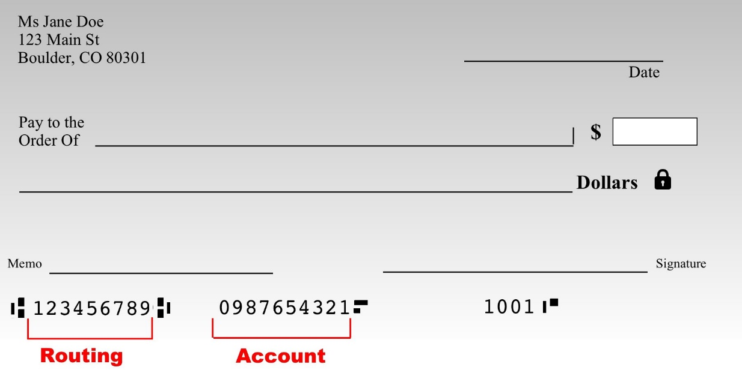
Tithes
Salary:
Gross - $2,000.00
Net - $1,800.00
10% of Gross - $2,000.00
Tithes = $200.00
Offerings = in kinds/cash or excess of your tithes
JRI
$200
Two Hundred Dollars Only
Tithes
Beth C.

Slide 34
Give to God What Belongs to Him
Why Should We Give?
To honor God
To support His work
To demonstrate trust and obedience
To grow in generosity
To position ourselves for God's blessings

Slide 35
Malachi 3:10 (NIV)
"Bring the whole tithe into the storehouse... Test me in this," says the Lord Almighty, "and see if I will not throw open the floodgates of heaven and pour out so much blessing that there will not be room enough to store it."

Slide 36
Give to God What Belongs to Him
How to Encourage People to Tithe:
• Start with a Biblical Foundation
• Explain the Purpose of Tithes and Offerings
• Encourage with Testimonies and Benefits
• Address Common Concerns

Slide 37
Summary: Basic Christian Lifestyle
Live a Life of Prayer and Intercession
Do Your Daily Devotion Consistently
Attend Your Cell Group Meetings
Attend Church Regularly
Join Christian Skills Development (Training)
Give to God What Belongs to Him (Tithes and Offerings)

Slide 38
The Vital Role of Leaders in Helping Their Members
A Life Group Leader is not just a teacher, but a shepherd guiding others toward Jesus.
Leaders set an example by living out the Basic Christian Lifestyle and helping members build a strong faith and relationship with God.
Encourage, don’t force, members to live by these principles to grow spiritually and deepen their relationship with Jesus.
Building a strong connection with your members will make your guidance more effective.
Leaders should be patient, faithful, and led by the Holy Spirit, trusting God’s guidance. Always include members in your prayers.
Lead by example, and trust that God will take care of the results in His perfect timing.

